Slide 1
Microcomputer Systems
Course Code: CSC 2106
Course Title: Computer Organization and Architecture
Dept. of Computer Science
Faculty of Science and Technology
Lecturer No: | 1 | Week No: | 1 | Semester: | Summer 23-24
Lecturer: | Md. Faruk Abdullah Al Sohan; faruk.sohan@aiub.edu

Slide 2
Lecture Outline
1. Introduction to the architecture of microcomputers
and IBM PC
2. Peripherals and their relations to the software or Programs
3. What computer does while executing instructions
4. Advantages and disadvantages of assembly language programming
**As a microcomputer user, you already know most of these terms

Slide 3
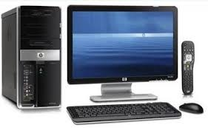
Components of Microcomputer System
SYSTEM UNIT
I/O DEVICES OR PERIPHERALS
  Keyboard
  Display Unit
  Disk drives
INTEGRATED-CIRCUIT (IC)
  Contains transistors. Digital circuits
  [0’s& 1’s]
  Each 0 or 1 here represents a transistor’s ON or OFF state inside the IC.
  Binary Digits/ Bits: 0 or 1
  **Peripherals = Devices attached to the computer that expand its functions.**

Slide 4
Components of Microcomputer System
CPU:
  Brain of the computers
  Controls all the operations
  A single chip processor (microprocessor)
MEMORY CIRCUITS : Stores information
I/O CIRCUITS : Communicate with I/O devices

Slide 5
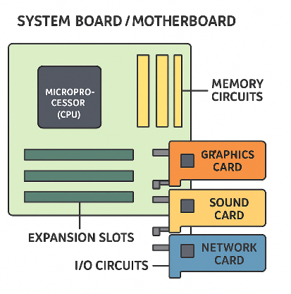
The System Board
System Board/motherboard resides in the system unit
It contains microprocessors and memory circuits
It has expansion slots to connect additional circuit boards called add-in cards/add-in boards
I/O circuits are located in add-in cards

Slide 6
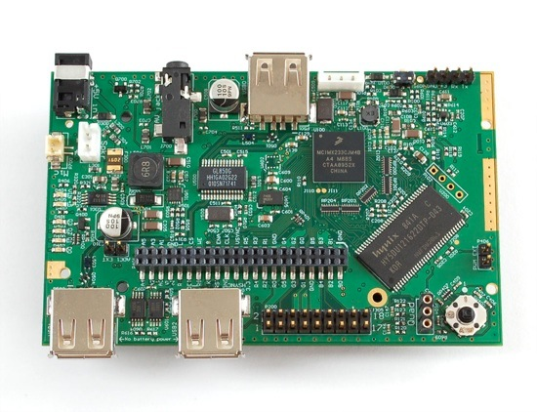
A Glimpse of Motherboard
The Components of a Microcomputer System

Slide 7
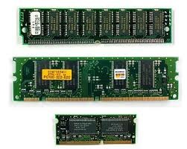
Memory
Bytes and Words:
Information processed is stored in memory
A memory circuit element can store one bit of data [i.e. 0 or 1]
Memory circuits are organized as a group of 8 bits of data
8 bits of string = 1 Byte
Memory bytes are known as address( i.e. street address of a house).
**A memory byte is the smallest accessible unit of data in a computer’s memory.**
It consists of 8 bits (each bit is 0 or 1).

Slide 8
Previous Slide Explanation
Bit and Bytes
The computer’s memory stores information in small electronic components called memory circuits.
Each memory element can store one bit of data — either 0 or 1.
These bits are grouped into 8 bits, and that group is called a Byte.
👉 1 Byte = 8 bits
Bytes are used to represent characters, numbers, or other types of data in memory.
Example: The letter ‘A’ = 01000001 (1 byte)

Slide 9
Difference b/w Bit and Bytes
Feature | Bit | Byte
Definition | Smallest unit of data in a computer (binary digit) | A group of 8 bits
Symbol | b | B
Value | Either 0 or 1 | Combination of 8 bits (e.g., 01001101)
Represents | A single binary value | A character, symbol, or small amount of data
Example | 1 or 0 | 01000001 = ‘A’
Size | 1/8 of a byte | 8 bits = 1 byte
Usage | Used to measure data transfer speed (e.g., Mbps) | Used to measure file size or memory (e.g., MB, GB)

Slide 10
Explanation
Think of computer memory like a row of houses:
Each house = 1 byte
Each house has an address (number) so you can find it

Slide 11
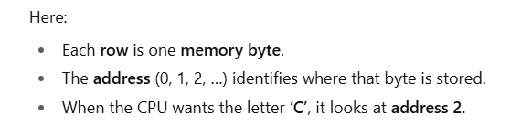
Address
Memory Address | Data (in bits) | Data (in characters)
0 | 01000001 | ‘A’
1 | 01000010 | ‘B’
2 | 01000011 | ‘C’
3 | 01000100 | ‘D’

Slide 12
Address Vs Contents
The stored data in a memory byte are called contents/value.
Address | Contents
The address of a memory byte is FIXED and different from other addresses( unique). | Contents are NOT unique as they deal with current data.
The number of bits in an address depend on the processor [ i.e. Intel 8086 = 20-bit & Intel 80286=24-bit ] | Contents of memory byte are always 8 bits

Slide 13
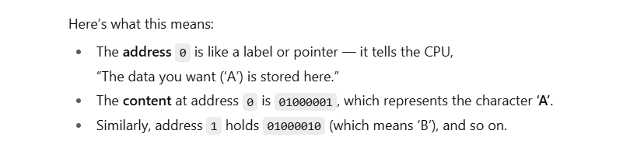
Explanation
Memory Address | Data (in bits) | Data (in characters)
0 | 01000001 | ‘A’
1 | 01000010 | ‘B’
2 | 01000011 | ‘C’
3 | 01000100 | ‘D’

Slide 14
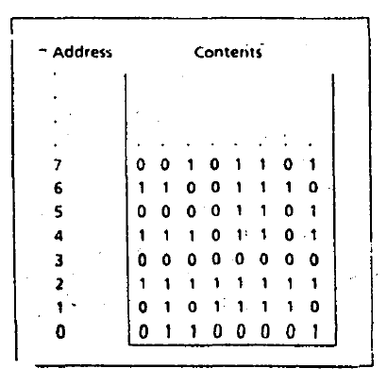
Address Vs Contents

Slide 15
Memory byte addressing
Suppose a processor uses 20 bits for an address. How many memory bytes can be addressed using this processor?
    A bit can have two possible values (i.e. 0 or 1)
    So, in a 20-bit address, we can have 2²⁰ or 10,48,576
In computer terminology 2²⁰ = 1 Mega
Therefore, 20-bit address can be used to address 1 MB.

Slide 16
Memory Word
In a Microcomputer, Two bytes = a word
So to store a word data, IBM PC needs :
    A pair of successive memory bytes
    A pair of memory bytes = Memory word
The lower address of the two memory bytes is the memory address.
    i.e. a memory word with address 2 is made up of address 2 and 3
A microprocessor can detect memory byte or memory word from memory location/address.

Slide 17
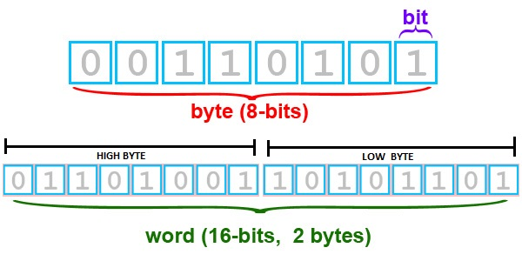
Bit Positions in byte and Word
Bit positions are numbered from Right to left
Bit 0-7 = low byte [ Lower address of word]
Bit 8-15 = high byte [ Higher address of word]

Slide 18
Explanation
PDF I WILL SHARE WITH YOU.

Slide 19
Memory Operations
The processor can perform two operations on memory
  Read or fetch the contents from a location
    Processor only gets a copy of the data
    Original contents of the location are unchanged
  Write or Store data at a location
    The data written become the new contents
    The Original/previous contents are lost

Slide 20
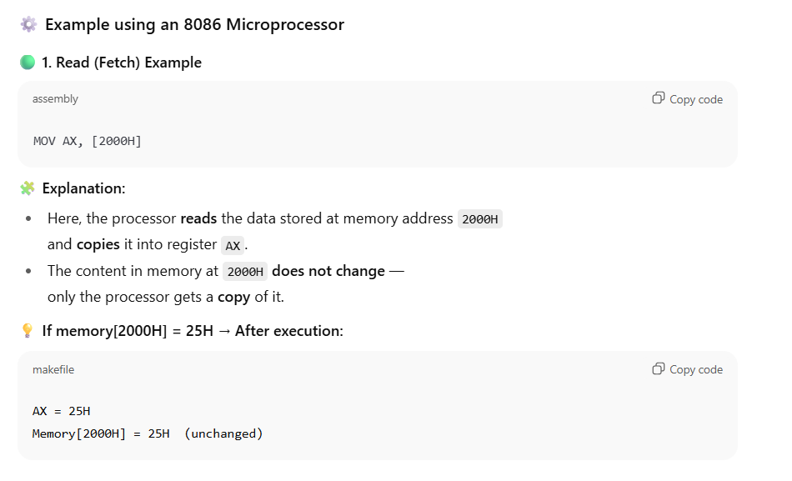
Explain

Slide 21
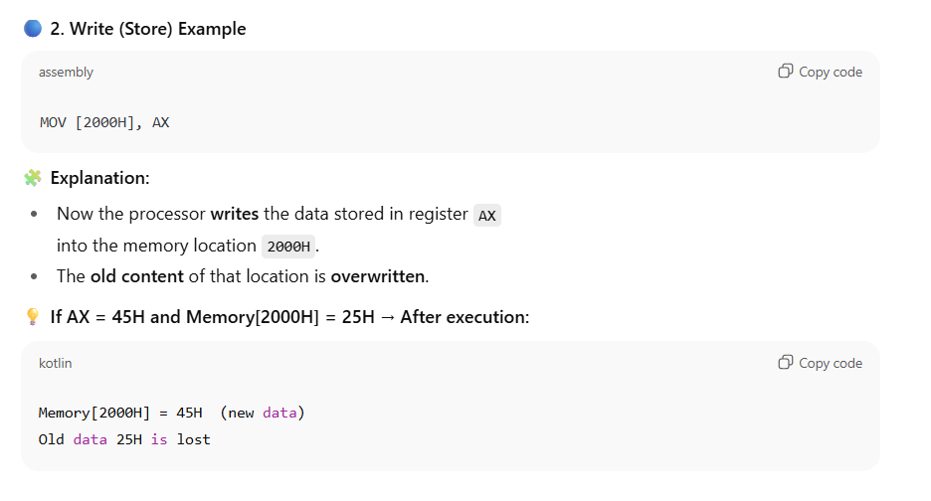
Explain

Slide 22
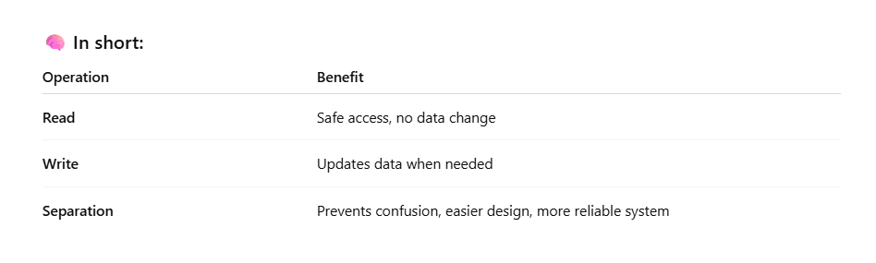
Explanation

Slide 23
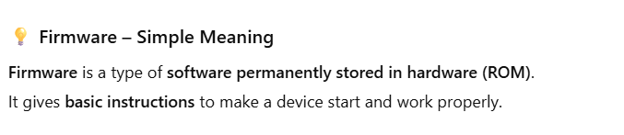
RAM and ROM
RAM: Random Access Memory
    RAM locations can be read and written
    Program instructions and data are stored
    RAM memory are lost when the machine is turned off
ROM: Read Only Memory
    Once initialized can’t be changed (Read Only)
    Retain values unlike RAM [example]
    ROM based programs are known as firmware
    Responsible for loading start-up programs

Slide 24
BUSES
A processor communicates with memory and I/O devices by using signals.
Signals are travelled along set of wires or connections called buses.
There are three kinds of signals and buses
      Address → Address Buses
      Data → Data Buses
      Control → Control Buses

Slide 25
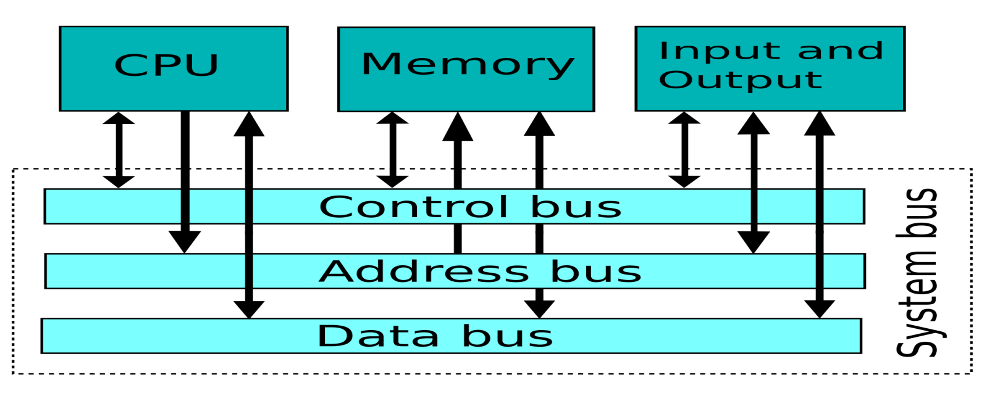
BUSES(cont’d…)
Address Bus: The CPU places the address of memory location on address bus to read the contents.
Data Bus: CPU receives the data, sent by memory circuits on the data bus.
Control Bus: CPU sends control signals on control bus perform read operation in memory.

Slide 26
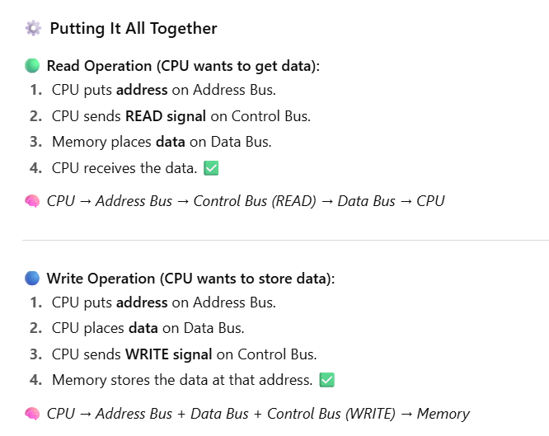
Explain

Slide 27
CPU
CPU is the brain of computer.
CPU controls computer by executing programs (i.e. system or application).
Each instruction CPU executes, is a bit string.
Machine language: The language of 0’s and 1’s
    Instructions are designed to be simple
    Sequence of very basic operations
Instruction Set: The instructions performed by CPU.
    The instructions set for each CPU is unique

Slide 28
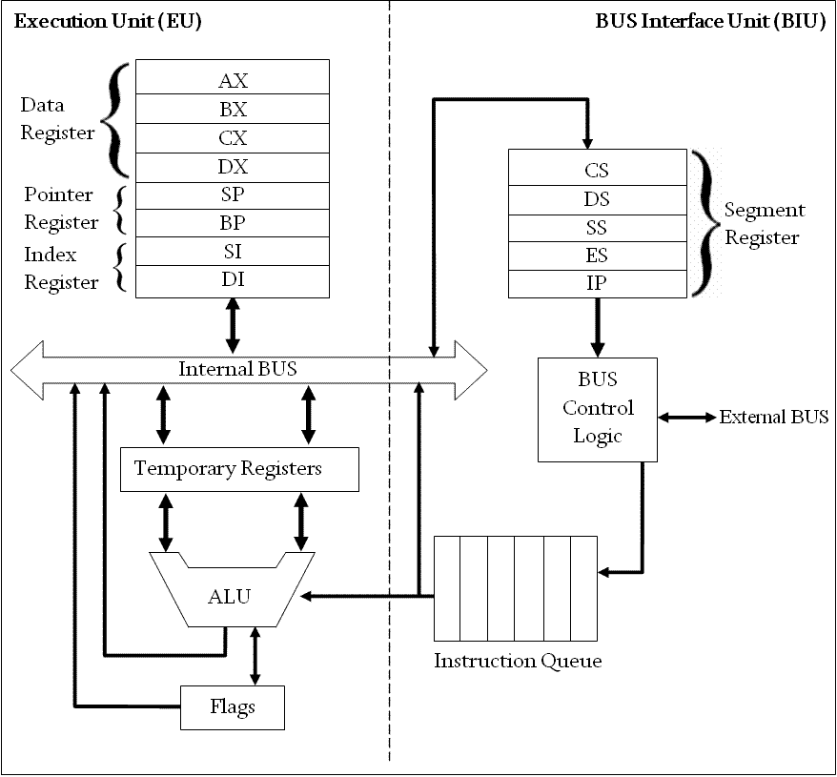
Intel 8086 Microprocessor Organization

Slide 29
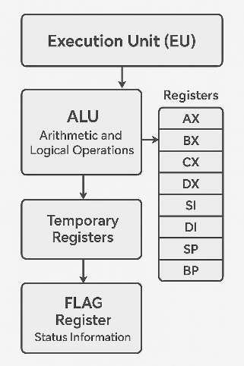
Execution Unit (EU)
EU contains ALU circuits.
ALU performs arithmetic and logical operations.
Data operations are stored in registers.
A register is like memory location; however, we refer to it by name not number.
    i.e. AX, BX, CX, DX, SI, DI, SP, BP
Also, EU Contains temporary registers for holding operands for the ALU and FLAGS registers.
FLAG register’s individual bits reflect the result of computation

Slide 30
Bus Interface Unit (BIU)
BIU enables communication between the EU and memory or I/O circuits.
Primarily responsible for transmitting address, data and control signals on the buses.
BIU registers are: CS,DS, ES and IP
    BIU registers hold the addresses of the memory locations

Slide 31
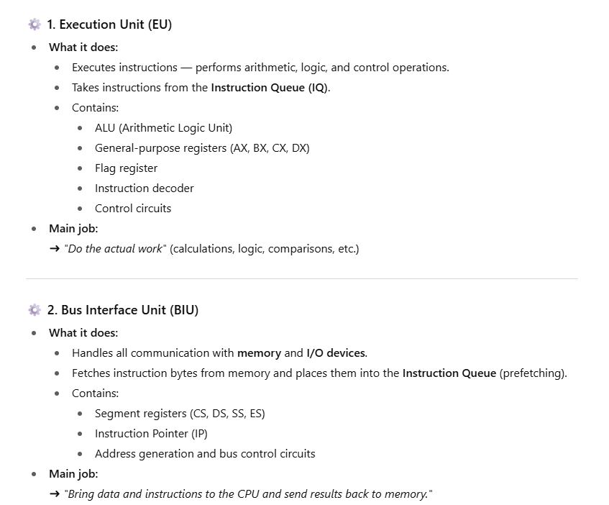
Explanation

Slide 32
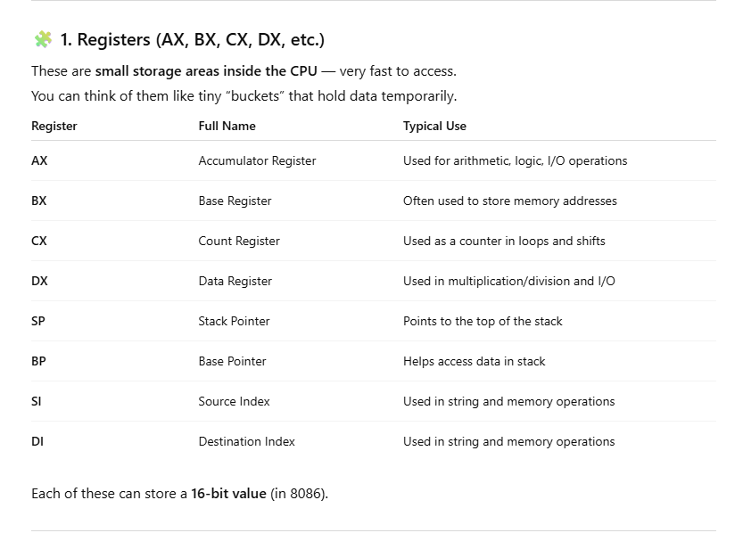
Explain

Slide 33
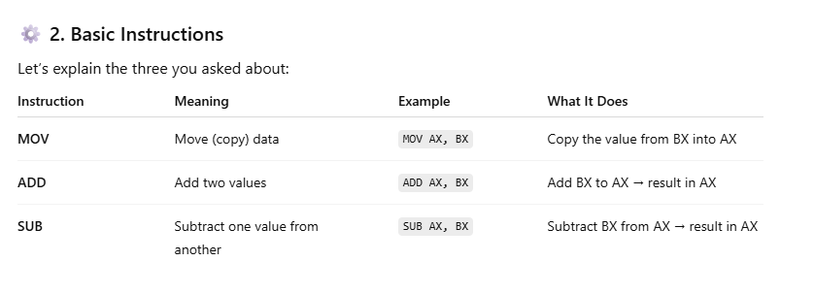
Explain

Slide 34
EU and BIU
EU and BIU are connected by internal bus and they work together.
While EU executes an Instruction, BIU fetches up to six bytes of the next instruction and places instructions in instruction queue (IQ).
The overall process is called instruction prefetch and it’s purpose is to speed up the processor.
However, if EU needs to communicate with memory, BIU suspends instruction prefetch and performs required operations.

Slide 35
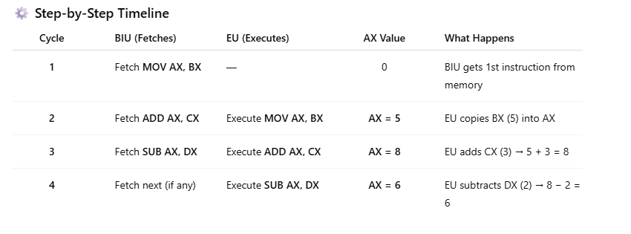


Slide 36
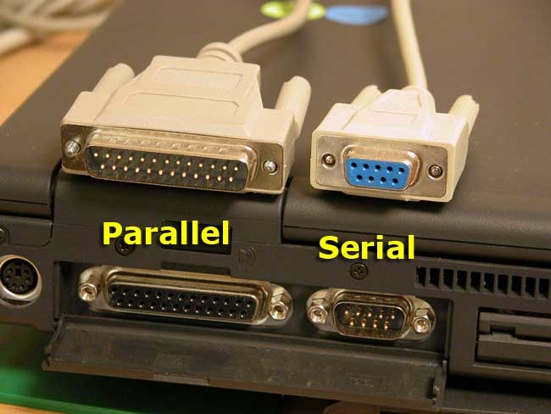
I/O Ports
I/O ports functions as transfer points between the CPU and I/O devices.
I/O devices are connected through I/O ports
Serial | Parallel
Transfers 1 bit at a time | Transfers 8 or 16 bits at a time
Serial ports tend to be slower | Requires more wiring connection
Slow devices are connected to serial port. (i.e. Keyboard) | Fast devices are connected to parallel port. (i.e. disk drive)

Slide 37
Instruction Execution
How the CPU operated?
Machine language has two parts
    Opcode: Type of operation
    Operands: Data to be operated on (Memory addresses are used)
The fetch- execute cycle
  Fetch
      Fetch an instruction from memory
      Decode the instruction to determine the operation
      Fetch data from memory if necessary
  Execute cycle
      Perform operation on the data
      Store the result if needed

Slide 38
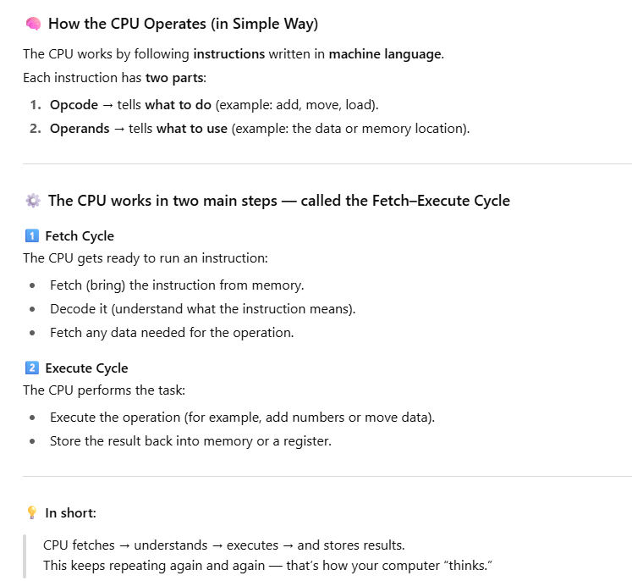
Explain

Slide 39
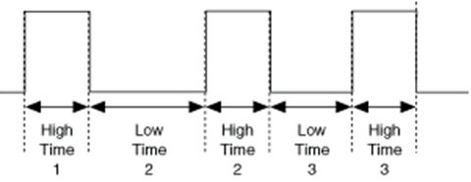
Timing
To ensure execution steps are carried out in an orderly fashion, a clock circuit controls the processor by generating a train of clock pulses
  Clock Period: The time interval between two pulses.
  Clock rate/speed: Number of Pulses per second.
      Measured in Megahertz (MHz)
      1 MHz = 1000000 (1 million) pulses per second

Slide 40
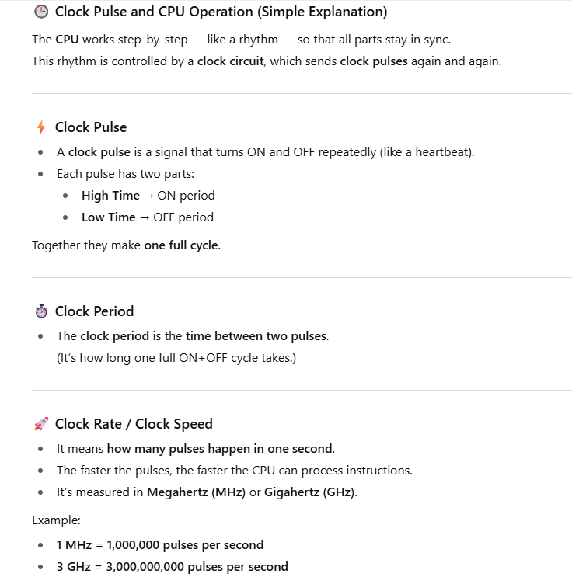
Explain

Slide 41
Timing Task
If you have computer with processor 2.3 GHz, How many pulses are generated per seconds from your computer?
    2.3 X 1000,000,000 = 2,30,00,00,000 pulses

Slide 42
Programming Languages
Machine Language: Bit strings (i.e. 0 & 1)
Assembly language:
    Symbolic names are used to represent operations, registers and memory locations(i.e. MOV AX, A)
    Assembly program must be converted into machine language using assembler.
High-Level language:
    Allows programmer to write program in more natural language text.
    A Compiler is needed to translate high-level programs into machine language

Slide 43
Advantages
High-level
Assembly
Closer to natural language. So, algorithm conversion in easier.
Less instruction and time required than assembly language.
Programs can be executed in any machine
So close to the machine language. So programs are faster and shorter.
Reading or writing to specific memory location, I/O ports is easy.
It can be a sub program of a high-level language.
Going into more details like how computer thinks.

Slide 44
References
Assembly Language Programming and Organization of the IBM PC, Ytha Yu and Charles Marut, McGraw Hill, 1992. (ISBN: 0-07-072692-2).
https://www.researchgate.net/publication/323880534_Lecture_1_Introduction_to_Microcomputer_Microprocessor

Slide 45
Books
Assembly Language Programming and Organization of the IBM PC, Ytha Yu and Charles Marut, McGraw Hill, 1992. (ISBN: 0-07-072692-2).
Essentials of Computer Organization and Architecture, (Third Edition), Linda Null and Julia Lobur
W. Stallings, “Computer Organization and Architecture: Designing for performance”, 67h Edition, Prentice Hall of India, 2003, ISBN 81 – 203 – 2962 – 7
Computer Organization and Architecture by John P. Haynes.

